Slide 1
Investigating team planning strategies of the human-AI teams in a bomb disposal game
Lixiao Huang, Prithvi Prathapan, Sai Sushank Manthri Pramod
| Team Members
Dr. Atkinson | IFT536 Natural Language Processing
The Polytechnic School | Ira A Fulton Schools of Engineering
Arizona State University
Spring 2024

Slide 2
Introduction
Team planning is essential for team success.
Game scenario: A team of 3 members aim to defuse bombs to save a town, and an AI advisor is tasked to help the team improve their teamwork. The team can only communicate with text chat in the shop before going to the field to execute the plan or return to the shop during the game.
Research question:
What themes do teams talk about in their planning across different AI advisor conditions?

Slide 3

Literature
Marks et al. (2001) taxonomy distinguishes between proactive, reactive, and contingency planning procedures when examining team planning tactics. These procedures can affect team performance and coordination at various stages of job completion (DeChurch & Haas, 2008).
Regarding proactive and reactive approaches to project scheduling under uncertainty, competence frameworks is essential in mitigating disruptions. It introduces sufficient conditions for the existence of admissible solutions, particularly in the context of competency-based redundancy in project teams.(Szwarc et al., 2021)

Slide 4
Literature (cont’d)
In a study in anaesthesia and critical care, a brief planning discussion before a simulated critical situation significantly improved clinical performance. Similarly, exploring how human-AI teams engage in planning discussions and adapt their strategies could shed light on optimizing performance in high-stakes scenarios like bomb disposal (Evain & Lilot, 2019).
An in-depth exploration of team sport coaches' planning practices highlighted the importance of explicit learning intentions, sequencing of practice session content, and contextual factors influencing planning. Planning processes in coaching needs for a deeper understanding of individual session planning in team sports coaching (Kinnerk & Lyons, 2023).

Slide 5
Environmental Scan
What else is available that accomplishes similar tasks?
Python environment programming language and documentation
NLP concepts such as Linguistic Theory, Tokenization, semantic analysis
ChatGPT APIs to generate specific codes and themes
Academic Journals and Dataset
What does your project address that others do not?
We are using LLM (gpt4) APIs to automatically code our training dataset instead of manual coding, and for further topic analysis.
Addresses the specific challenges of effective communication, resource allocation, task assignment, and in-game coordination within team planning, focusing on promoting collaboration, communication, and flexibility to enhance overall team performance and adaptability.

Slide 6
NLP Principles and Theories
The following principles and theories are necessary for our project.
Linguistic Theory: Linguistic theories provide the foundation for understanding the structure and meaning of human language. They include syntax (the structure of sentences), semantics (the meaning of words and sentences), and pragmatics (the context in which language is used).
Our project deals with syntax, semantics, and pragmatics.
Part-of-Speech (POS) Tagging: POS tagging involves labeling each word in a sentence with its corresponding part of speech (e.g., noun, verb, adjective). This information is essential for understanding the grammatical structure of sentences.
We tried to identify the most frequently used verbs.
Machine Learning and Deep Learning: Machine learning and deep learning techniques play a significant role in NLP, enabling computers to learn patterns and relationships in language data. Models like recurrent neural networks (RNNs), convolutional neural networks (CNNs), and transformer-based architectures (e.g., BERT, GPT) have shown remarkable performance in various NLP tasks.
We tried using chatGPT to classify the text chat themes.
Language Models: Language models are statistical models that learn the probability of sequences of words. They are used for tasks such as language generation, machine translation, and text summarization.
We analyzed the frequency of words.
Pragmatics: Pragmatics deals with the study of language in use and the context in which communication takes place. It considers factors such as speaker intentions, implicature, and conversational implicature.
My knowledge of the game context help me interpret the data.

Slide 7
What Tools were used?
What Tools did you use?
Python - Sklearn, ngram, nltk, Keras, Pandas
Chatgpt API
Microsoft Excel - To manipulate filter and sort the data
AntConc: Professor recommended this tool, and it turns out to be useful.
Did you use common NLP tools? Why? Why not?
Among the Common NLP tools we used only Text classification and Standard Python Pandas Data manipulation. There was no need to use common nlp tools such as Text blob, pytorch.

Slide 8
Data Description, Collection, Processing, & Analysis
The data consists of 1160 games of 3-member team with a valid end-of-game status report on the testbed.
3 minutes of recon at the field, planning at the shop, and execution in the field, and interactive planning and execution.
Team needs to work together to reach high score
Data Collection:
The data was collected in Fall 2023 from the DARPA ASIST program.
Pre-Processing:
The data are extracted from testbed logs and organized into csv files with timestamps and message contents; we turned the csv files into txt.
In the AntConc approach, we used stoplist.
Analysis:
We used three approaches for analysis: (a) manual coding; (b) AntConc; (c) Machine learning
Notes:
Isn't’ attributes the same words as characteristics?

Slide 9
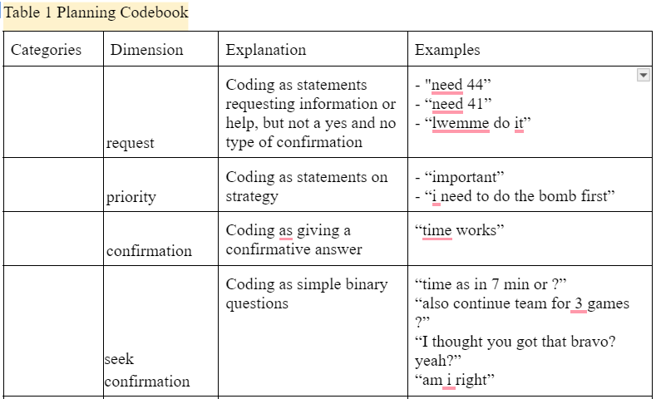
Manual coding approach: Codebook Example
The complete table of codebook: link here; Data sheet: link here

Slide 10
Manual coding outcomes
Two coders coded 3 trials for each AI advisor condition separately, and we developed a codebook for it (shown on the previous slide).
Unexpectedly, the two coders coded the data totally differently. We are supposed to discuss the codebook but were given different direction on the data analysis and aborted manual coding.
Themes: priority, request, confirmation, seek confirmation, command, courtesy, navigation, Report, goal setting, inquiry, express emotions, coordination, seeking attention, correcting, explanation, seeking clarification, and other.
These themes are not categorized further due to a lack of a framework

Slide 11
AntConc Approach
AntConc is a free tool for corpus linguistics research (Anthony, 2023).
The AntConc approach involves using a text analysis software called AntConc to analyze linguistic patterns in a dataset. It offers tools for tasks like concordancing, collocation analysis, and word frequency analysis, making it popular for linguistic research.
AntConc include concordancing, which displays every occurrence of a word along with its context in the dataset, collocation analysis, which identifies words frequently occurring together, and word frequency analysis, which highlights the most commonly used words in the text.
Researchers often use AntConc to uncover linguistic patterns, identify recurring themes, and gain insights into the structure and content of a corpus.

Slide 12
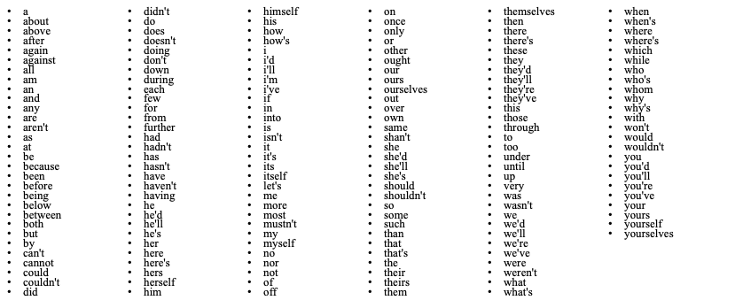
The stop list we used in AntConc

Slide 13
AntConc Outcomes
Word list
None |  | CMU |  | DOLL
Type | Freq | Type | Freq | Type | Freq
can | 133 | ok | 122 | ok | 275
forest | 110 | can | 118 | ready | 178
ok | 110 | desert | 81 | bomb | 160
one | 95 | bomb | 66 | go | 129
desert | 91 | forest | 59 | get | 128
bomb | 88 | im | 57 | one | 123
s | 88 | s | 57 | forest | 122
im | 83 | get | 56 | s | 120
solo | 71 | ill | 56 | shop | 107
get | 69 | just | 55 | desert | 106
go | 65 | done | 54 | need | 104
town | 64 | one | 53 | im | 93
ill | 62 | town | 52 | got | 88
need | 62 | go | 50 | bombs | 83
got | 58 | got | 48 | buy | 82
just | 57 | yeah | 42 | alpha | 76
done | 56 | min | 41 | oh | 76
yeah | 51 | solo | 40 | red | 73
hi | 46 | time | 34 | green | 70
ll | 43 | guys | 33 | ll | 70
In the top 20 words by advisor condition, None has five verbs: can, get, go, need, and got. CMU has four verbs: can, get, go, and got. DOLL has five verbs: go, get, need, got, and buy.
Surprisingly, DOLL condition did not have the word “can” on the list.
Get and go are the most common words in all three conditions’ top 3 verbs.
It also shows many teams did not talk much and the data quality is not great.

Slide 14
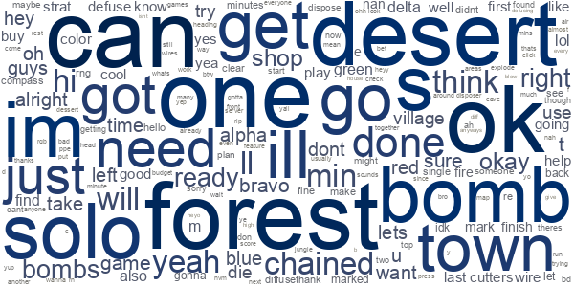
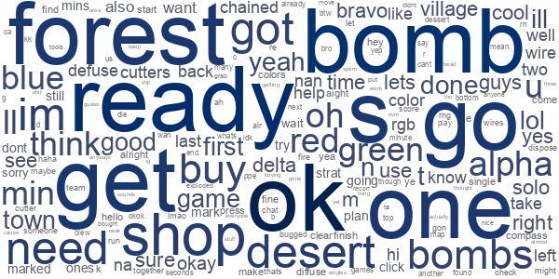
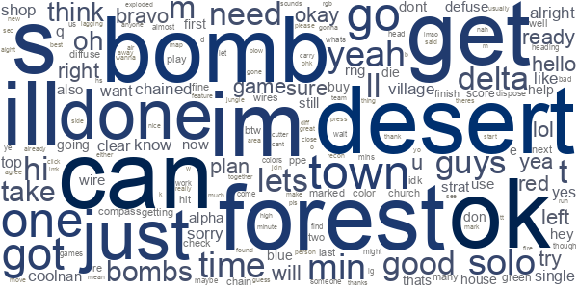
AntConc outcomes_Wordcloud
The wordclouds below show that players talk similarly about navigation a lot, such as desert, forest, town, and shop.
None
CMU
DOLL

Slide 15
Machine Learning Approach
Machine Learning Approach Evaluation:
Accuracy rate of 13% indicates challenges in predicting message themes.
Despite limitations, the analysis provides valuable insights into dataset complexities.
Verb Analysis and Clustering:
Identified most common verb n-grams and grouped them into clusters.
Clusters reveal distinct communication patterns and planning strategies within teams.

Slide 16
Machine Learning Outcomes
ML Approach Outcome: Achieved a 13% accuracy rate in predicting message themes.
Dataset Analysis: Utilized verb extraction, n-gram analysis, and clustering to understand prevalent actions and communication patterns.
Planning Strategies: Identified action-oriented discussions, diverse planning approaches, and communication styles within team interactions.
Practical Implications: Provided valuable insights for improving team coordination, workflow prioritization, and task execution based on verb usage and clustering findings.
Notes:
Interpreting Results:
- Understanding common actions and tasks discussed in messages.
- Insight into teams' planning strategies based on verb usage patterns and clusters.
Practical Implications:
- Leveraging verb analysis and clustering findings to enhance team performance and streamline processes.
- Valuable insights for improving coordination and achieving mission success in human-AI teaming scenarios.

Slide 17
Challenges
When participants say things, not every sentence is a grammatically correct full sentence. They sometimes break one sentence into several parts, which creates difficulty in coding and counting.
In the manual coding approach, two coders had extremely low agreement rates, and we did not proceed with this method due to new instructions to explore more advanced data analysis methods. There is a lack of a team planning framework to categorize the themes we came up with from the dataset.
In the AntConc approach, we could not find a solution to find all the verbs in the dataset. The internet’s solution and using verbs.csv did not help.
In the machine learning approach, though the chatGPT can automatically process a large dataset, the current chatGPTmodel has low accuracy in classifying the chat text.

Slide 18
Partial References
Anthony, L. (2023). AntConc (Version 4.2.4) [Computer Software]. Tokyo, Japan: Waseda University. Available from https://www.laurenceanthony.net/software
DeChurch, L. A., & Haas, C. D. (2008). Examining team planning through an episodic lens: Effects of deliberate, contingency, and reactive planning on team effectiveness. Small Group Research, 39(5), 542-568.
Szwarc, E., Nielsen, I., Smutnicki, C., Bocewicz, G., Banaszak, Z., & Bilski, J. (2021). Competence-oriented project team planning–university case study. Journal of Information and Telecommunication, 5(3), 310-333.
Evain, J. N., Perrot, A., Vincent, A., Cejka, J. C., Bauer, C., Duclos, A., ... & Lilot, M. (2019). Team planning discussion and clinical performance: a prospective, randomised, controlled simulation trial. Anaesthesia, 74(4), 488-496.
Kinnerk, P., Kearney, P. E., Harvey, S., & Lyons, M. (2023). An investigation of high-performance team sport coaches’ planning practices. Sports Coaching Review, 12(3), 253-280.

